Slide 1
Capstone Project Approval
Project Title : Adversarial Password Cracking
Project ID : PW21SE01
Project Guide : Prof. Sushma E
Project Team : 1600_1621
Vinayaka Hegde PES1201701600
S Thejas PES1201701621

Slide 2
Outline
Problem Statement
Motivation/Background study
Proposed Solution/Methodology
Software/Hardware/Data Requirements
Expected Deliverables
Capstone (Phase-I & Phase-II) Project Timeline
Any other information

Slide 3
Problem Statement
Adversarial Password Cracking
Train a generative adversarial network using PassGAN (consists of a generator that tries to generate a guess and a discriminator that prevents the generator from generating a guess) to check the robustness of user passwords.
Compare this with other methods like Hashcat, John the ripper.
Evaluate the strength of Adversarial system using zxcvbn.

Slide 4
Motivation/Background study
Existing password cracking tools like hashcat,John The Ripper need rules and prior knowledge of dataset to crack passwords.
PassGAN overcomes this problem by learning the distribution of passwords from actual password leaks and is proven to be must faster than rule-based password generation tools.
Also checking password strength in real time is a future work in one of the survey papers.

Slide 5
Literature Survey
Annie Chen Tufts University, “Presenting New Dangers: A Deep Learning Approach to Password Cracking”, Fall 2018.
passGan does not differ by large amount compared to existing techniques
51-73% more password match combining results of passGan and Hashcat
B. Hitaj, P. Gasti, G. Ateniese, and F. Perez-Cruz, “PassGAN: A Deep Learning Approach for Password Guessing,” Feb 2019.
Development and testing new rules time consuming
Expanding to model further password laborious task
Neural network trained without any assumption of property or rules

Slide 6
Literature Survey
V. Garg and L. Ahuja, "Password Guessing Using Deep Learning," 2019 2nd International Conference on Power Energy, Environment and Intelligent Control (PEEIC), Greater Noida, India
Explored various causes of data breaches.
Compared time taken by various kinds of attacks to crack passwords.
Used PassGAN on collections #1-5 data dump.
Nepal, S., Isaac Kontomah, Ini Oguntola and D. Wang. “Adversarial Password Cracking” (2019).
Trained PassGAN on rockyou and AshleyMadison dataset.
Also used zxcvbn to crack passwords in the above datasets.
FutureWork : Implementing password strength checker using PassGAN.

Slide 7
Project Scope and Use Case
The proposed model can be used as a security measure where in system administrators can check for easily crackable passwords.
It can find its applications in checking/suggesting password strength in real time.
The model can substitute other password cracking tools since it does not require knowledge of dataset. Also the samples generated are not limited to a password space.

Slide 8
Proposed Solution/Methodology
Train PassGAN on rockyou dataset and test it on multiple other datasets. And compare the results of PassGAN with other rule based methods like hashcat.
Then compare the results of PaasGAN with zxcvbn by visualizing results.
Try to estimate the strength of user entered passwords in real time using PassGAN.

Slide 9
Software/Hardware/Data Requirements
Languages/Technologies:
Python
Tensorflow
Keras
Software Engineering methodology:
Agile methodology - since project can be broken down into various modules and iteratively test implementations / make corrections.
Data Source:
Common password list (rockyou from kaggle)

Slide 10
Expected Deliverables
Capstone-I deliverables
Do a literature survey on various topics related to the project - PassGAN , hashcat , zxcvbn , etc.
High level design of project followed by implementation the PassGAN.
Comparing the results of our model with other password cracking techniques.
Capstone-II deliverables
Further research on usage of context of passwords while training.
Strive to extend the model to suggest password strength in real time.
Final integration of components and completing project report.

Slide 11
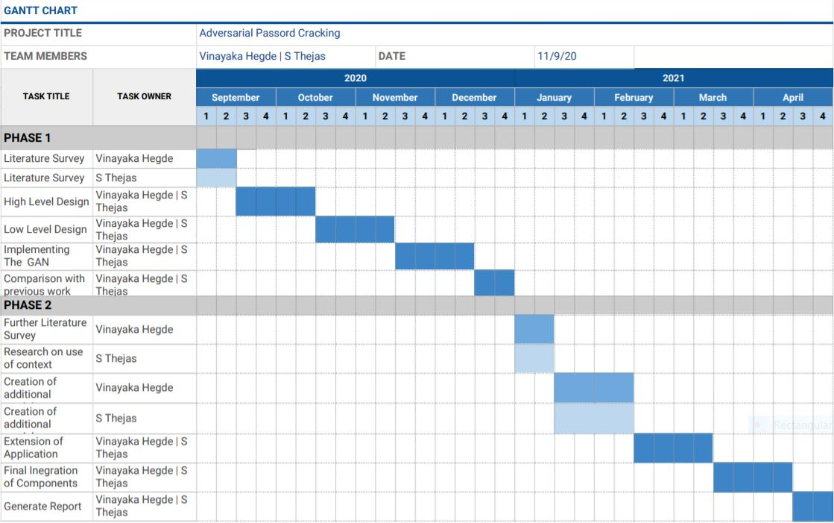
Capstone (Phase-I & Phase-II) Project Timeline

Slide 12
Any other information
Additional References
https://en.wikipedia.org/wiki/Password_cracking
http://www.cs.tufts.edu/comp/116/archive/fall2018/jgowgiel-supporting.pdf

Slide 13
Thank You

